Slide 1


SIMATS ENGINEERING
SAVEETHA INSTITUTE OF MEDICAL AND TECHNICAL SCIENCES
Capstone project presentation
SentinelX AI: Next-Generation Autonomous Cyber Defense Platform
CSA1707 - ARTIFICIAL INTELLIGENCE
Presented by:
Geferlin Boffy R (192571080)
Jayashree M (192524373)
J O Joanna Divine (192572003)
Anupratha C (192573024)
Guided By:-
Dr. R.Veeramani

Slide 2

INTRODUCTION
Cybersecurity is important for protecting systems, networks, and data from cyber attacks.
Large amounts of security logs make it difficult to manually identify threats.
AI and Machine Learning can help detect suspicious activities automatically.
AI Sentinel analyzes logs and identifies possible cyber threats.
The system provides threat alerts, severity levels, MITRE ATT&CK mapping, and security recommendations.

Slide 3

ABSTRACT
AI Sentinel is an AI-based cybersecurity application for detecting cyber threats.
It analyzes system and network logs to identify suspicious activities.
Machine Learning is used to detect and classify different types of threats.
The system maps detected threats to the MITRE ATT&CK framework and provides security recommendations.
A dashboard displays threats, alerts, severity levels, and reports for easy monitoring.

Slide 4
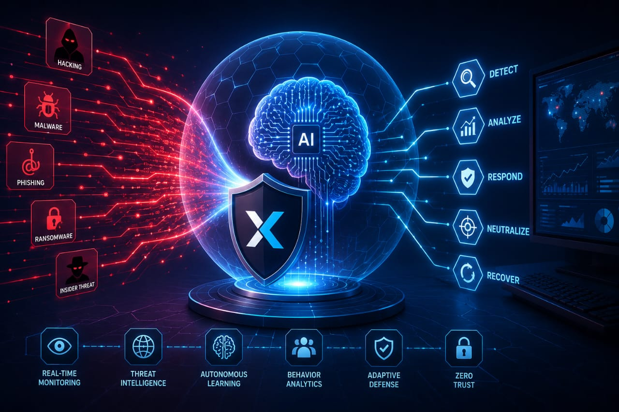
PROBLEM STATEMENT
Difficulty in threat detection: Large volumes of system and network logs make it difficult for security teams to identify suspicious activities manually.
Limitations of traditional systems: Rule-based security systems may fail to detect new or unknown attacks and can generate a high number of false alerts.
Need for intelligent monitoring: A smart AI-based solution is needed to automatically analyze logs, identify and classify threats, assess their severity, and provide useful security alerts.

Slide 5
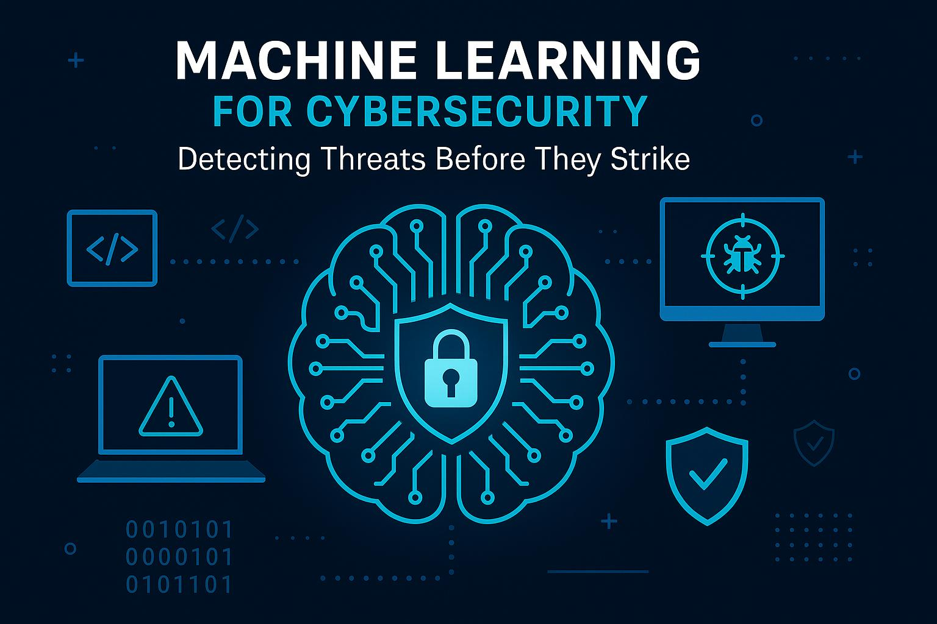
OBJECTIVES
To develop an AI-powered platform for real-time cyber threat detection and monitoring.
To detect suspicious activities and cyber attacks using Machine Learning algorithms.
To predict potential cyber threats based on historical attack patterns.
To provide Explainable AI (XAI) for transparent and understandable threat detection.

Slide 6

Existing System
Traditional cybersecurity systems mainly depend on predefined rules and signatures to detect threats.
Security teams manually monitor system and network logs.
Existing SIEM tools collect and visualize security events.
Threat detection is often based on known attack patterns.
Some systems provide limited automated response and threat analysis.

Slide 7

Proposed System
AI Sentinel is an AI-powered cybersecurity platform that automatically analyzes system logs, detects suspicious activities, classifies cyber threats, and provides security recommendations. The system uses machine learning for threat detection and maps identified attacks to the MITRE ATT&CK framework.

Slide 8
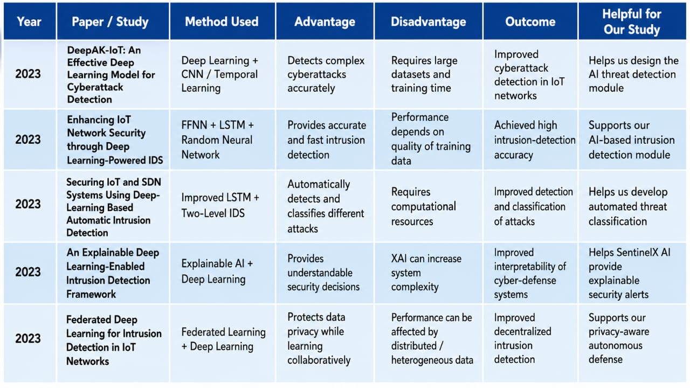
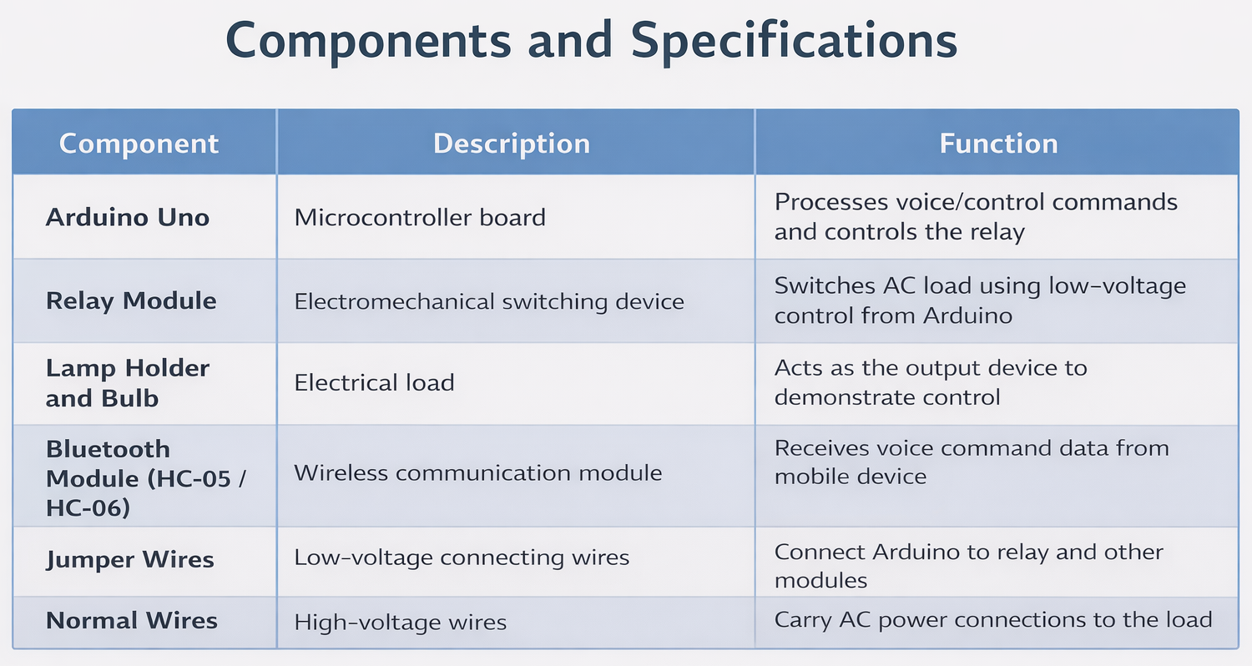
LITERATURE REVIEW

Slide 9
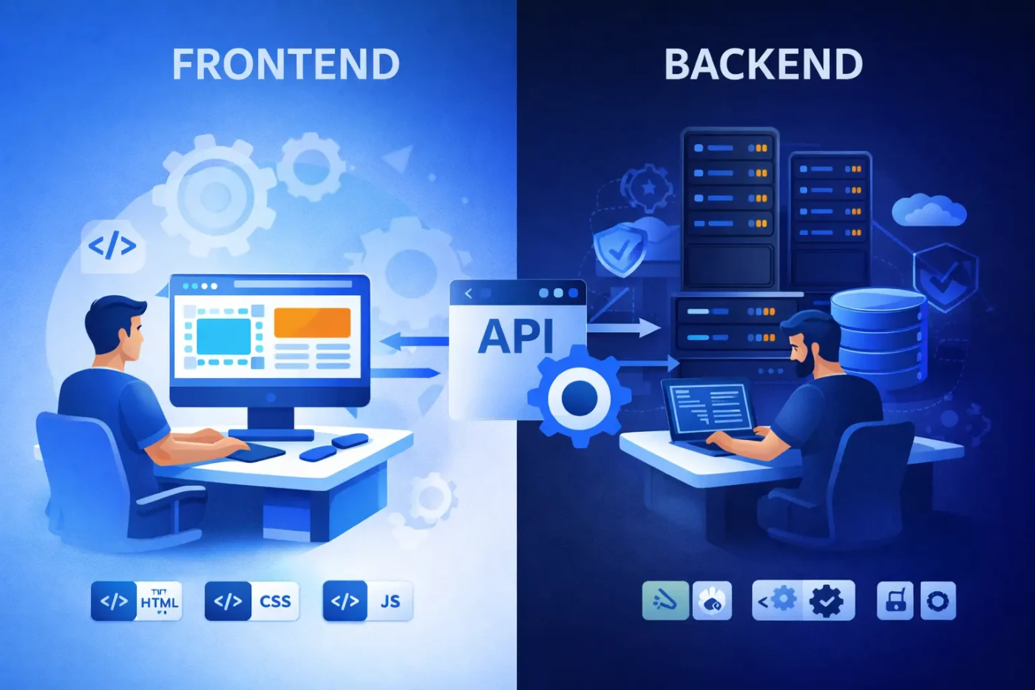

Technologies
Frontend
React.js – User interface
HTML, CSS, Tailwind CSS – Design and styling
Chart.js – Security charts and visualization
Backend
Python – Core backend and AI processing
FastAPI – REST API development
Scikit-learn – Machine Learning
MySQL – Database
Tools
VS Code – Development
Git & GitHub – Version control
Postman – API testing
MITRE ATT&CK – Threat mapping
Jupyter Notebook – ML model development

Slide 10
Module 1: Log Collection & Preprocessing Module
Collects security logs from servers, network devices, firewalls, IDS/IPS, and applications.
Allows administrators to upload log files or receive logs through an API.
Removes duplicate, incomplete, and irrelevant log entries.
Extracts important features such as IP address, timestamp, user, event type, status, and request information.
Converts raw logs into a structured format suitable for AI/ML analysis.

Slide 11
Module 2:AI-Based Threat Detection Module
Uses Machine Learning algorithms to identify suspicious and abnormal activities.
Detects potential threats such as Brute Force, Malware, DoS, and SQL Injection.
Uses anomaly detection to identify unusual behavior that may not match known attack patterns.
Classifies detected activities into appropriate threat categories.
Assigns a confidence score and severity level such as Low, Medium, High, or Critical

Slide 12
Module 3:MITRE ATT&CK & Response Module
Maps detected threats to the corresponding MITRE ATT&CK tactics and techniques.
Provides information about the detected attack and its potential impact.
Generates recommended security actions for administrators.
Produces alerts when high-risk or critical threats are detected.
Helps administrators understand the attack and take appropriate defensive measures

Slide 13
Module 4:Security Dashboard & Reporting Module
Provides an interactive dashboard for monitoring the overall security status.
Displays total logs, detected threats, critical alerts, threat categories, and trends.
Shows detailed information about individual threats and their MITRE ATT&CK mappings.
Provides filtering and searching of security events.
Generates security reports that can be used for analysis and documentation.

Slide 14
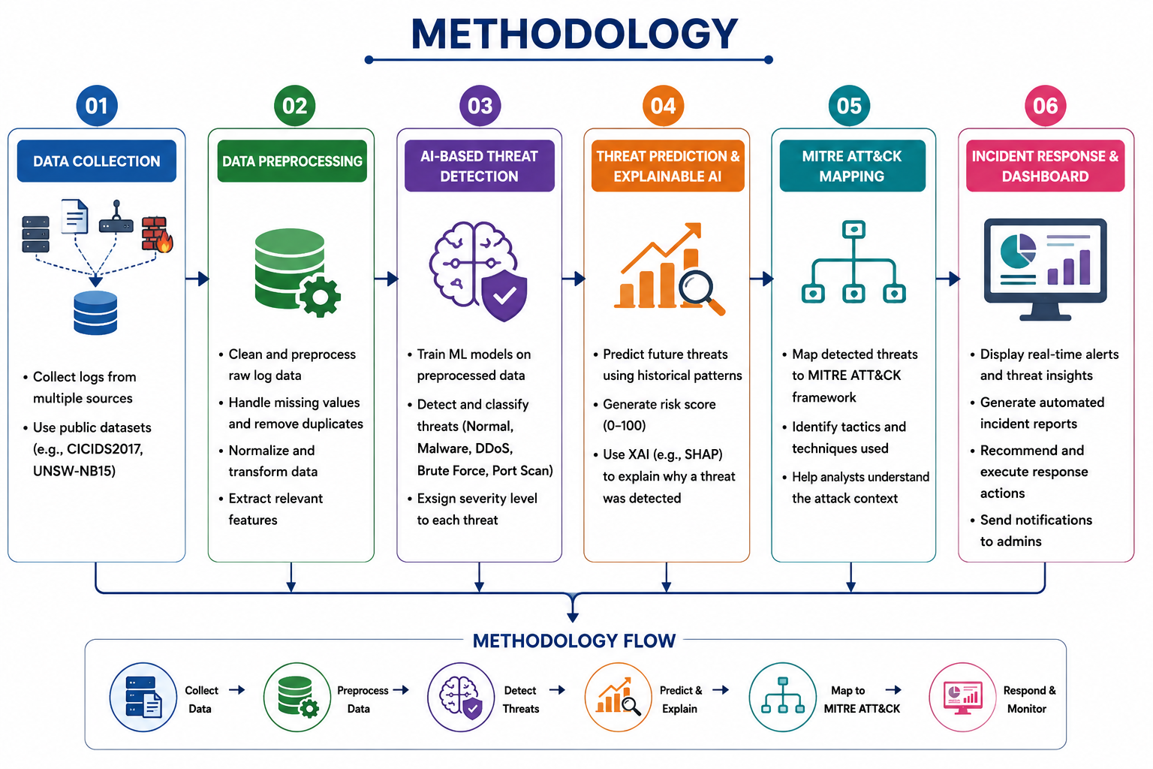
METHODOLOGY

Slide 15
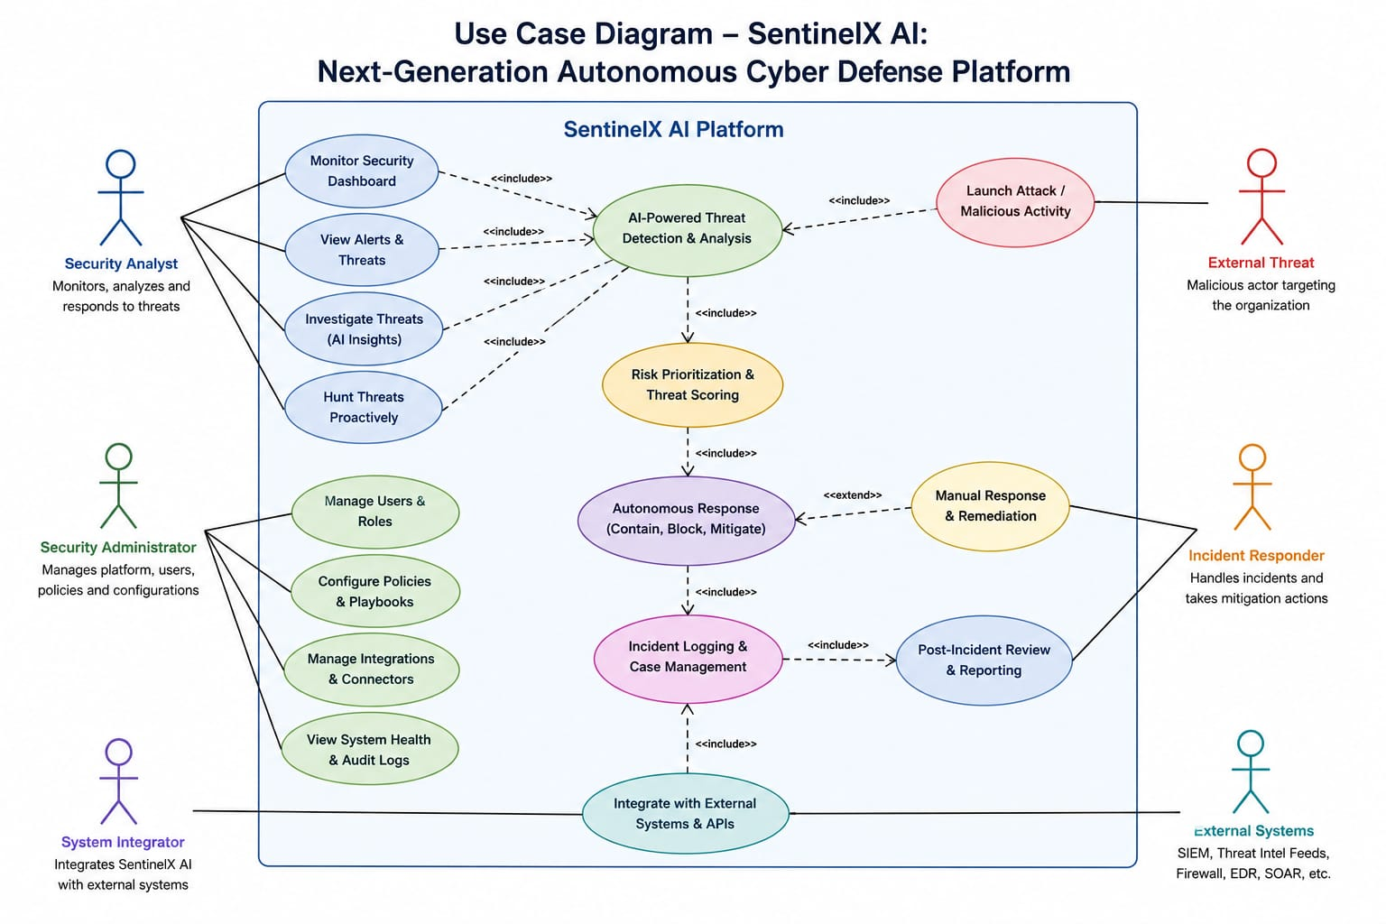
Usecase Diagram

Slide 16
RESULTS & DISCUSSION
Threat Detection: The system analyzes security logs and detects suspicious activities using AI/ML.
Threat Classification: Detected activities are classified into different types such as Brute Force, Malware, DoS, and SQL Injection.
Risk Analysis: The system assigns a severity level such as Low, Medium, High, or Critical to each detected threat.
MITRE Mapping: Detected threats are mapped to the relevant MITRE ATT&CK techniques to understand the attack pattern.
Security Monitoring: The dashboard displays threats, alerts, and reports, helping administrators monitor and respond to security incidents quickly.

Slide 17
CONCLUSION & FUTURE SCOPE
AI Sentinel provides an AI-based solution for detecting and analyzing suspicious activities from security logs.
The system classifies threats, assigns severity levels, and maps attacks to the MITRE ATT&CK framework.
The dashboard provides easy monitoring of threats, alerts, logs, and security reports.
In the future, the system can support real-time monitoring and integration with cloud platforms and other security tools.
Advanced AI/deep learning and automated threat response can be added to improve detection accuracy and respond to new cyber threats faster.

Slide 18
REFERENCES
□
MITRE ATT&CK – Cybersecurity knowledge base for identifying attack tactics and techniques. MITRE ATT&CK
NIST Cybersecurity Framework – Guidelines for cybersecurity risk management and threat detection. NIST Cybersecurity Framework
Scikit-learn – Machine learning library used for classification and anomaly detection. Scikit-learn Documentation
FastAPI – Python framework used for developing the backend APIs. FastAPI Documentation
React – JavaScript library used to develop the application's frontend and dashboard. React Documentation

Slide 19


